Slide 1



PhD Comprehensive Exam Meeting
Development of Multimodal Quantitative MRI Techniques to Assess Brain Tissue Microstructure in Multiple Sclerosis
Mathieu Boudreau
December 20th 2012
Biomedical Engineering Dept.
McGill University
Committee:
Prof. Bruce Pike - Supervisor
Prof. Robert Funnell - Chair’s representative
Dr. Douglas Arnold - External member

Slide 2
Overview
Introduction
Background
MS
MRI Techniques
Progress
Lab
Personal
Hypotheses
Research plan
Resources
Timeline/Potential Problems
Conclusion
Notes:
BRIEF OVERVIEW OF PROPOSAL

Slide 3
Introduction
Multiple Sclerosis: disabling neurological disease affecting 55,000-75,000 Canadians.
MRI: imaging modality uniquely sensitive to many aspects of MS pathology.
Quantitative Magnetization Transfer: MRI technique capable of quantifying changes in myelin density.
Most qMT research of MS concentrate on white matter pathology, partly due to time and resolution limitations.
We aim to develop a fast high-resolution qMT method for white and gray matter MS pathology in the whole-brain to investigate the spatial relationship between pathology in both tissues.
1
Notes:
TRIGGER of MS is unknown
there is currently NO CURE

Slide 4
Introduction
Multiple Sclerosis: disabling neurological disease affecting 55,000-75,000 Canadians.
MRI: imaging modality uniquely sensitive to many aspects of MS pathology.
Quantitative Magnetization Transfer: MRI technique capable of quantifying changes in myelin density.
Most qMT research of MS concentrate on white matter pathology, partly due to time and resolution limitations.
We aim to develop a fast high-resolution qMT method for white and gray matter MS pathology in the whole-brain to investigate the spatial relationship between pathology in both tissues.
1
Notes:
CONVENTIONAL MRI – CLINICAL DIAGNOSIS

Slide 5
Introduction
Multiple Sclerosis: disabling neurological disease affecting 55,000-75,000 Canadians.
MRI: imaging modality uniquely sensitive to many aspects of MS pathology.
Quantitative Magnetization Transfer: MRI technique capable of quantifying changes in myelin density.
Most qMT research of MS concentrate on white matter pathology, partly due to time and resolution limitations.
We aim to develop a fast high-resolution qMT method for white and gray matter MS pathology in the whole-brain to investigate the spatial relationship between pathology in both tissues.
1
Notes:
SOME MT MEASURES CORRELATE WITH MYELIN DENSITY

Slide 6
Introduction
Multiple Sclerosis: disabling neurological disease affecting 55,000-75,000 Canadians.
MRI: imaging modality uniquely sensitive to many aspects of MS pathology.
Quantitative Magnetization Transfer: MRI technique capable of quantifying changes in myelin density.
Most qMT research of MS concentrate on white matter pathology, partly due to time and resolution limitations.
We aim to develop a fast high-resolution qMT method for white and gray matter MS pathology in the whole-brain to investigate the spatial relationship between pathology in both tissues.
1
Notes:
qMT FOCUS WM LESIONS. RES LIMIT
+ MS CONSIDERED A WM DISEASE

Slide 7
Introduction
Multiple Sclerosis: disabling neurological disease affecting 55,000-75,000 Canadians.
MRI: imaging modality uniquely sensitive to many aspects of MS pathology.
Quantitative Magnetization Transfer: MRI technique capable of quantifying changes in myelin density.
Most qMT research of MS concentrate on white matter pathology, partly due to time and resolution limitations.
We aim to develop a fast high-resolution qMT method for white and gray matter MS pathology in the whole-brain to investigate the spatial relationship between pathology in both tissues.
1

Slide 8
Background - MS
The McDonald Criteria (2010 Revision) for diagnosing MS requires conventional MRI measurements of lesions.
At diagnosis, MS is usually characterized by intermittent attacks of focal WM inflammation and demyelination, separated by periods of relative stability.
Pathological indications of MS: inflammation, blood-brain barrier breakdown, demyelination, olygodendrocyte loss, remyelination, gliosis, axonal damage and atrophy.
Quantifying GM pathology is important to fully assess the burden of disease in MS as it is a correlate with neurological dysfunction.
2
Notes:
GOLD STANDARD FOR DIAGNOSING MS

Slide 9
Background - MS
The McDonald Criteria (2010 Revision) for diagnosing MS requires conventional MRI measurements of lesions.
At diagnosis, MS is usually characterized by intermittent attacks of focal WM inflammation and demyelination, separated by periods of relative stability.
Pathological indications of MS: inflammation, blood-brain barrier breakdown, demyelination, olygodendrocyte loss, remyelination, gliosis, axonal damage and atrophy.
Quantifying GM pathology is important to fully assess the burden of disease in MS as it is a correlate with neurological dysfunction.
2
Notes:
MRI LESIONS != CORRELATE WITH CLINICAL ATTACKS

Slide 10
Background - MS
The McDonald Criteria (2010 Revision) for diagnosing MS requires conventional MRI measurements of lesions.
At diagnosis, MS is usually characterized by intermittent attacks of focal WM inflammation and demyelination, separated by periods of relative stability.
Pathological indications of MS: inflammation, blood-brain barrier breakdown, demyelination, olygodendrocyte loss, remyelination, gliosis, axonal damage and atrophy.
Quantifying GM pathology is important to fully assess the burden of disease in MS as it is a correlate with neurological dysfunction.
2

Slide 11
Background - MS
The McDonald Criteria (2010 Revision) for diagnosing MS requires conventional MRI measurements of lesions.
At diagnosis, MS is usually characterized by intermittent attacks of focal WM inflammation and demyelination, separated by periods of relative stability.
Pathological indications of MS: inflammation, blood-brain barrier breakdown, demyelination, olygodendrocyte loss, remyelination, gliosis, axonal damage and atrophy.
Quantifying GM pathology is important to fully assess the burden of disease in MS as it is a correlate with neurological dysfunction.
2
Notes:
GM PATHOLOGY DIFFERENT FROM WM

Slide 12
Background – Conventional MRI
Mostly hyperintense T₂-weighted lesions: dissemination of lesions in space and time.
Active lesions are hyperintense in contrast-enhanced T₁-weighted images.
Most lesions are detected in WM; cortical GM lesions typically are not detected with conventional MRI.
3
Notes:
T2 – QUALITATIVE MEASURE
GD-T1 – Early sign of Lesion (BBB)

Slide 13
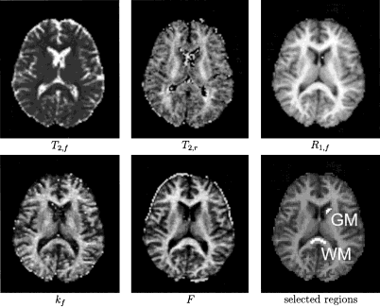
Background – Magnetization Transfer
Saturation of macromolecular pool leads to reduced signal from the free pool through the magnetization transfer effect.
Bloch-McConnell equation – models the magnetization evolution as a function of the pool ratio, relaxation rates, and cross-relaxation rates.
Comparison with histology showed that the pool ratio (F) correlated with myelin density (Schmierer et al, 2004).
Sled et al, 2001
4
Notes:
qMT ALLOWS MEASUREMENT OF QUANTITATIVE PROPERTIES OF MS
Signal Hydrogen in Macromolecules UNDETECTABLE with MRI
MT EFFECT RESULTS IN LOWER SIGNAL IN REGIONS OF HIGH MYELIN DENSITY

Slide 14
Background – Magnetization Transfer
Saturation of macromolecular pool leads to reduced signal from the free pool through the magnetization transfer effect.
Bloch-McConnell equation – models the magnetization evolution as a function of the pool ratio, relaxation rates, and cross-relaxation rates.
Comparison with histology showed that the pool ratio (F) correlated with myelin density (Schmierer et al, 2004).
Sled et al, 2001
4
Notes:
Many approximations to solve the EQUs. describing the SIGNAL

Slide 15
Background – Magnetization Transfer
Saturation of macromolecular pool leads to reduced signal from the free pool through the magnetization transfer effect.
Bloch-McConnell equation – models the magnetization evolution as a function of the pool ratio, relaxation rates, and cross-relaxation rates.
Comparison with histology showed that the pool ratio (F) correlated with myelin density (Schmierer et al, 2007).
Sled et al, 2001
4
Notes:
In WM – F has been shown to correlate well with myelin, measured from post-mortem histology
DRAWBACK OF MT – LOW RES, LONG ACQ

Slide 16

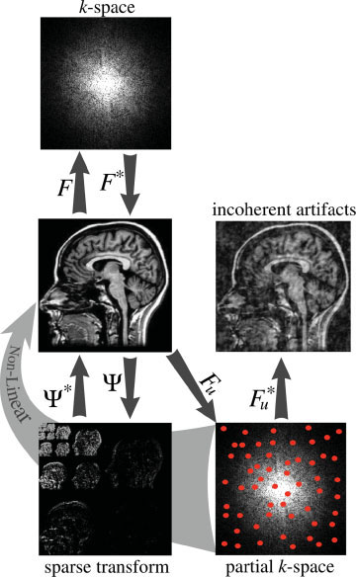
Background – Compressed Sensing
Sparse signals may be accurately reconstructed from random undersampling by solving a non-linear optimization problem.
Acq. Time (CS) < ½ Acq. Time (Full)
Increased image processing time.
No additional hardware required; minor pulse sequence changes.
Lustig et al, 2007
5
Notes:
BASIC CONCEPT OF CS
DESCRIBE IMAGE
DOMAIN WHERE IMAGE IS SPARSELY REPRESENTED

Slide 17
Background – Compressed Sensing
Sparse signals may be accurately reconstructed from random k-space undersampling by solving a non-linear optimization problem.
Acq. Time (CS) < ½ Acq. Time (Full)
Increased image processing time.
No additional hardware required; minor pulse sequence changes.
Lustig et al, 2007
5

Slide 18
Background – Compressed Sensing
Sparse signals may be accurately reconstructed from random k-space undersampling by solving a non-linear optimization problem.
Acq. Time (CS) < ½ Acq. Time (Full)
Increased image processing time.
No additional hardware required; minor pulse sequence changes.
Lustig et al, 2007
5

Slide 19
Background – Compressed Sensing
Sparse signals may be accurately reconstructed from random k-space undersampling by solving a non-linear optimization problem.
Acq. Time (CS) < ½ Acq. Time (Full)
Increased image processing time.
No additional hardware required; minor pulse sequence changes.
Lustig et al, 2007
5

Slide 20
Progress - Lab
Developed pulsed qMT model/method (full set of parameters).
Longitudinal qMT study of acute lesions in relapsing-remitting MS patients.
Robustness of model parameters (simulations, scan-rescan, optimized protocols).
Cortical GM pathology was quantified using hi-res voxel-based morphometry (VBM) of a post-mortem MS brain.
6
Notes:
Our lab developed the qMT model that we’re proposing to use
VBM correlated GM T1,T2, MTR with histology

Slide 21
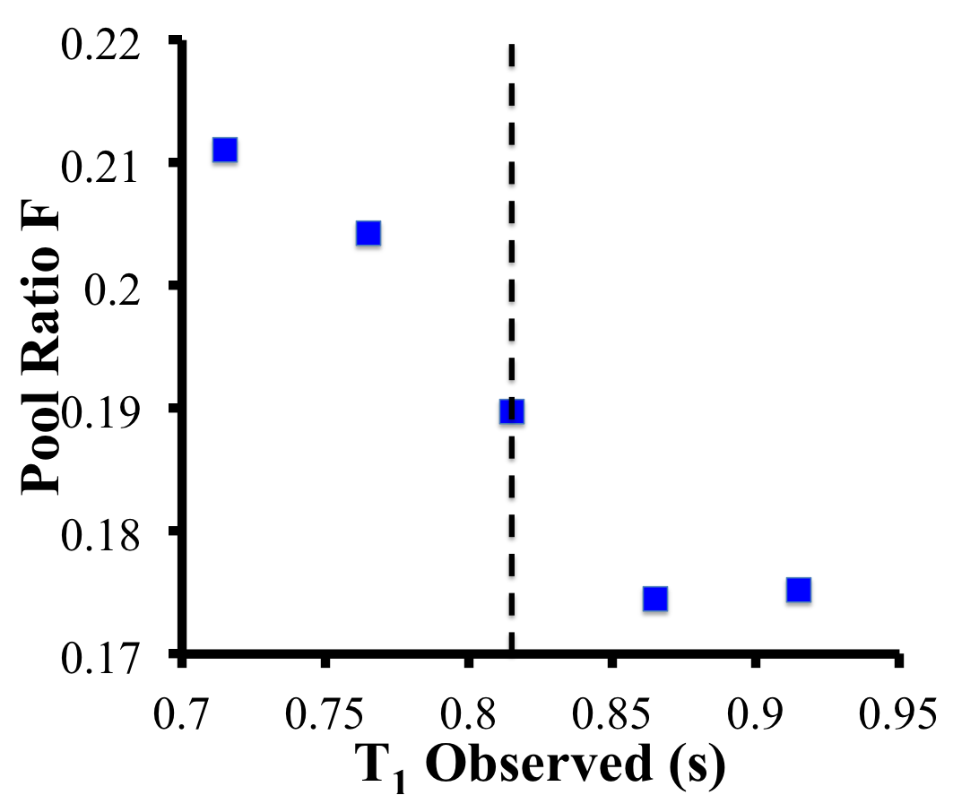
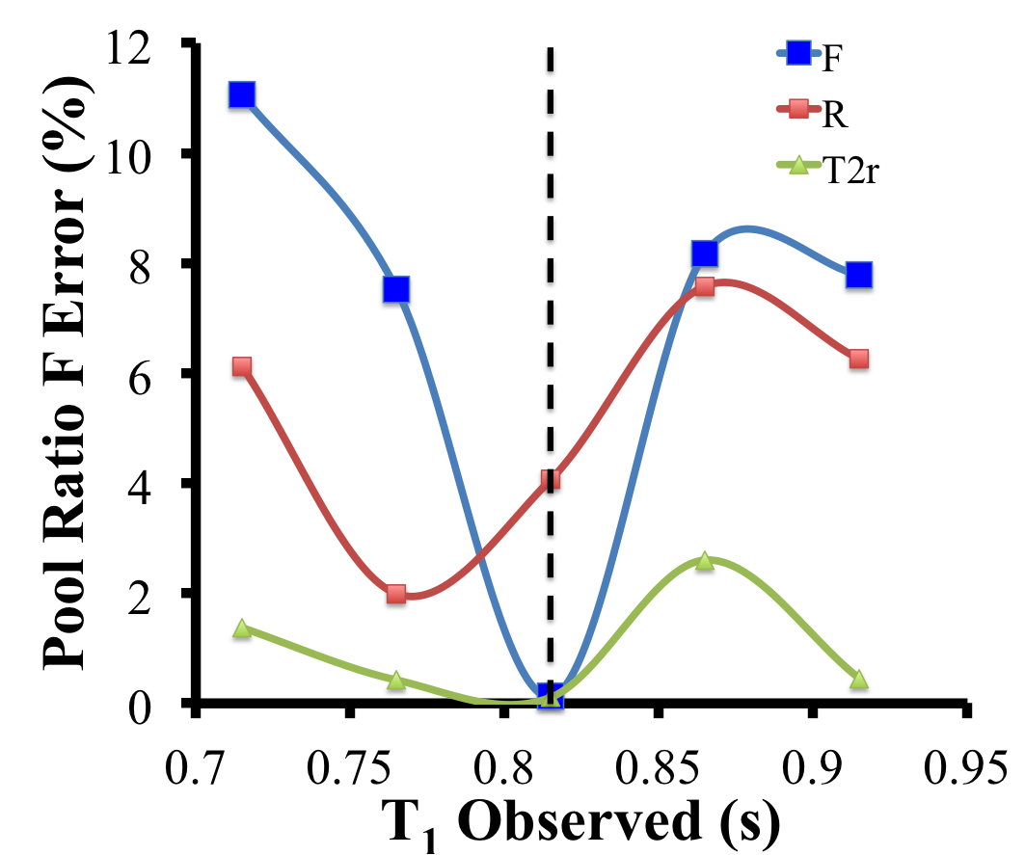
Progress – Personal (July 2012-Present)
Simulations investigating the effect of erroneous T₁ measurements on qMT parameters
Wavelet-based and Model-based compressed sensing reconstruction on simulated and in vivo data.
Investigated effects of imperfect spoiling and error in B₁ mapping on LL, IR and VFA T₁ mapping.
7
Notes:
EFFECT ON USING WRONG T1 VALUE ON QMT PARAMETERS

Slide 22
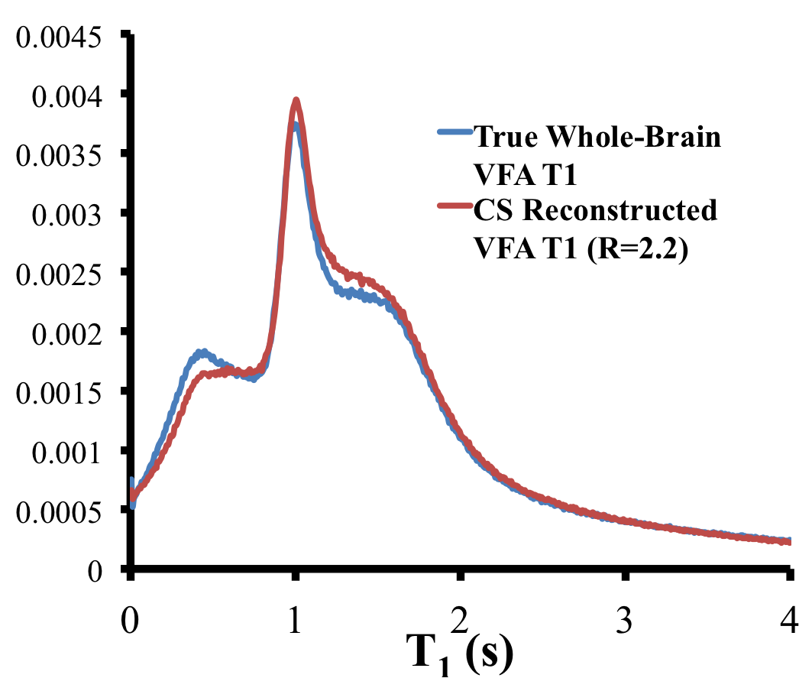
Progress – Personal (July 2012-Present)
Full K-Space
Wavelet CS (R=2.2)
Simulations investigating the effect of erroneous T₁ measurements on qMT parameters
Wavelet-based and Model-based compressed sensing reconstruction on simulated and in vivo data.
Investigated effects of imperfect spoiling and error in B₁ mapping on LL, IR and VFA T₁ mapping.
7
Notes:
INVESTIGATED LIMITATIONS OF TECHNIQUES
EFFECT OF COMPRESSED SENSING RECON ON T1 MAP

Slide 23
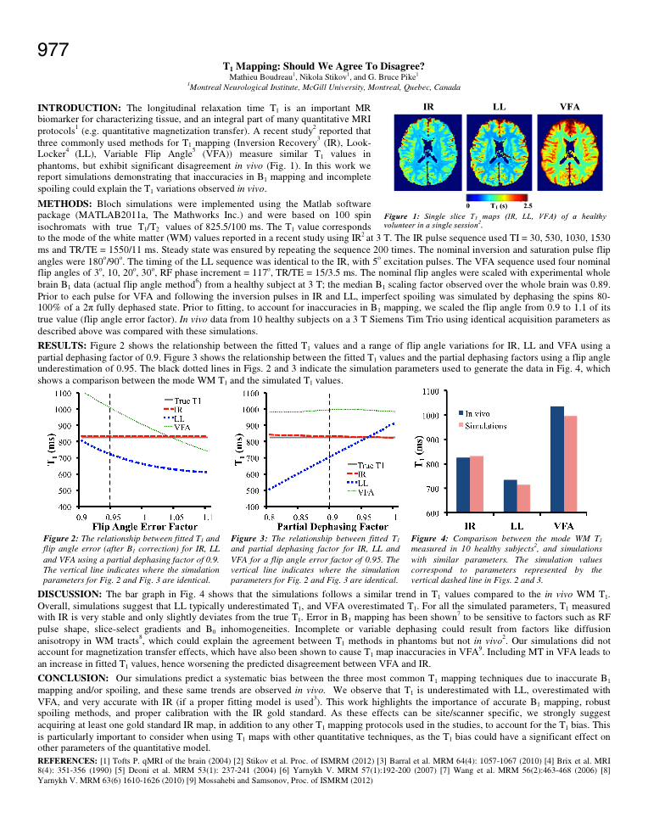
Progress – Personal (July 2012-Present)
Simulations investigating the effect of erroneous T₁ measurements on qMT parameters
Wavelet-based and Model-based compressed sensing reconstruction on simulated and in vivo data.
Investigated effects of imperfect spoiling and error in B₁ mapping on LL, IR and VFA T₁ mapping.
Submitted to ISMRM 2013
7
Notes:
SUBMITTED ABSTRACT – RELATED TO T1 METHODS DISAGREEMENT

Slide 24
Hypotheses
Whole-brain qMT maps can be acquired with a resolution of 1 mm³ in a clinically acceptable time of < 30 minutes.
High-resolution qMT WM/GM focal and diffuse pathology in post-mortem healthy and MS brains will correlate with immunohistochemistry measurements of pathology.
Is cortical GM MS pathology spatially independent of connectivity with WM lesions?
8
Notes:
3 HYPOTHESES FOR THIS PROECT ARE THE FOLLOWING

Slide 25
Hypotheses
Whole-brain qMT maps can be acquired with a resolution of 1 mm³ in a clinically acceptable time of < 30 minutes.
High-resolution qMT WM/GM focal and diffuse pathology in post-mortem healthy and MS brains will correlate with immunohistochemistry measurements of pathology.
Is cortical GM MS pathology spatially independent of connectivity with WM lesions?
8

Slide 26
Hypotheses
Whole-brain qMT maps can be acquired with a resolution of 1 mm³ in a clinically acceptable time of < 30 minutes.
High-resolution qMT WM/GM focal and diffuse pathology in post-mortem healthy and MS brains will correlate with immunohistochemistry measurements of pathology.
Is cortical GM MS pathology spatially independent of connectivity with WM lesions?
8

Slide 27
Research Plan – Aim 1 Develop a fast 3D high-resolution qMT acquisition protocol using compressed sensing having a clinically acceptable acquisition time.
3 T Siemens Tim Trio - 32 Channel head coil
Optimal qMT acquisition scheme
Shorter TR, fixing T_{2,r} to reduce number qMT measurements
Low-res 3D B₀ and B₁ (AFI) maps, fast 3D T1 mapping technique (VFA)
Compressed sensing
10 qMT measurements (256x192x128) with a TR = 15 ms and R = 4 would have an acquisition time of ~16 minutes.
Validation:
Single slice (1.5 T) vs. 3D (3 T)
Compressed Sensing vs. GRAPPA
Full vs. Optimized protocol
Agar phantoms, healthy subjects
9
Notes:
STATE AIM
SNR and ACQ TIME REDUCING ***STRATEGIES***

Slide 28
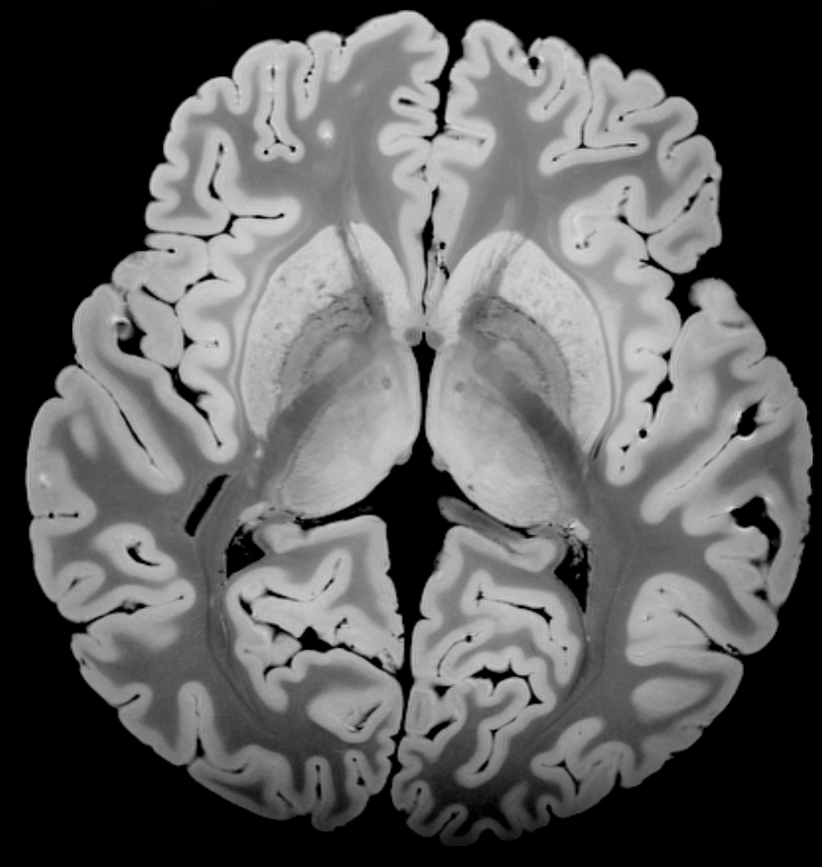
Research Plan – Aim 2 Quantitatively compare MS lesions in post-mortem brains between our optimized qMT protocol, a high-resolution qMT protocol and immunohistochemistry.
qMT measurements of post-mortem brain hemispheres (healthy and MS)
High resolution (350 μm isotropic) optimized qMT protocol
Correlate qMT measures with Immunohistochemistry
10

Slide 29
Research Plan – Aim 2 Quantitatively compare MS lesions in post-mortem brains between our optimized qMT protocol, a high-resolution qMT protocol and immunohistochemistry.
qMT measurements of post-mortem brain hemispheres (healthy and MS)
High resolution (350 μm isotropic) optimized qMT protocol
Correlate qMT measures with immunohistochemistry
10

Slide 30
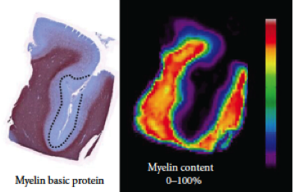
Research Plan – Aim 2 Quantitatively compare MS lesions in post-mortem brains between our optimized qMT protocol, a high-resolution qMT protocol and immunohistochemistry.
qMT measurements of post-mortem brain hemispheres (healthy and MS)
High resolution (350 μm isotropic) optimized qMT protocol
Correlate qMT measures with immunohistochemistry
100 %
0 %
Tardif et al, 2012
10

Slide 31
Research Plan – Aim 3 Evaluate whole-brain qMT protocol in MS patients and investigate the spatial connectivity between WM and GM MS pathology.
3D qMT protocol on secondary progressive MS patients and age/sex matched healthy volunteers.
Number of patients required for this study will be calculated from a power analysis, by considering the results of Aims 1 and 2.
Investigate cortical GM qMT values in healthy GM and GM lesions.
Acquire high angular resolution MRI diffusion tractography maps.
qMT parameters in cortical GM connected to WM lesions will be investigated to determine if they exhibit statistically different values compared to contra-lateral regions free of WM lesions.
11
Notes:
STATE AIM

Slide 32
Resources
Two on-site MRIs (Siemens 1.5 and 3 T)
32-channel head coil (3 T)
Siemens MR physicist available for assistance with pulse sequence development
State-of-the-art experimental neuropathology lab at the MNI.
Post-mortem brain hemispheres (healthy and MS) will be acquired through the Douglas Mental Health Brain Bank.
MS patients will be recruited through the MNI MS clinic.
12
Notes:
RECENT ARRIVAL OF SIEMENS MR PHYSICIST
Already STARTED LOOKING INTO IMPLEMENTING COMPRESSED SENSING ON SPGRE SEQUENCE

Slide 33
Resources
Two on-site MRIs (Siemens 1.5 and 3 T)
32-channel head coil (3 T)
Siemens MR physicist available for assistance with pulse sequence development
State-of-the-art experimental neuropathology lab at the MNI.
Post-mortem brain hemispheres (healthy and MS) will be acquired through the Douglas Mental Health Brain Bank.
MS patients will be recruited through the MNI MS clinic.
12

Slide 34
Resources
Two on-site MRIs (Siemens 1.5 and 3 T)
32-channel head coil (3 T)
Siemens MR physicist available for assistance with pulse sequence development
State-of-the-art experimental neuropathology lab at the MNI.
Post-mortem brain hemispheres (healthy and MS) will be acquired through the Douglas Mental Health Brain Bank.
MS patients will be recruited through the MNI MS clinic.
12

Slide 35
Resources
Two on-site MRIs (Siemens 1.5 and 3 T)
32-channel head coil (3 T)
Siemens MR physicist available for assistance with pulse sequence development
State-of-the-art experimental neuropathology lab at the MNI.
Post-mortem brain hemispheres (healthy and MS) will be acquired through the Douglas Mental Health Brain Bank.
MS patients will be recruited through the MNI MS clinic.
12

Slide 36
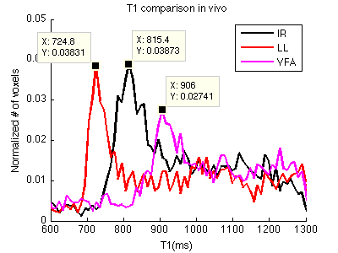
Potential Problems
Possible loss of low contrast image features when using compressed sensing.
Change in T₁ technique = Change in T₁ measured values
What will be the effect on F in vivo?
Use of stereotaxic WM DTI tractography maps if diffusion method fails in MS patients.
Stikov et al, 2012
13
Notes:
SOME FITTING PARAMETERS TWEEKABLE TO AID THIS
OTHERWISE< MAY ONLY ACCELERATE CERTAIN POINTS OF QMT MEASUREMENT
GRAPPA-SPIRIT

Slide 37
Potential Problems
Possible loss of low contrast image features when using compressed sensing.
Change in T₁ technique = Change in T₁ measured values
What will be the effect on F in vivo?
Use of stereotaxic WM DTI tractography maps if diffusion method fails in MS patients.
Stikov et al, 2012
14
Notes:
Did SIMULATIONS, now TEST IN VIVO

Slide 38
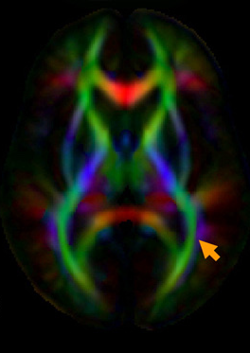
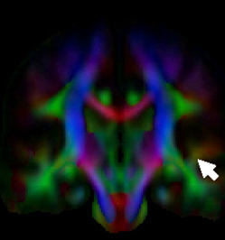
Potential Problems
Possible loss of low contrast image features when using compressed sensing.
Change in T₁ technique = Change in T₁ measured values
What will be the effect on F in vivo?
Use of stereotaxic WM DTI tractography maps if diffusion method fails in MS patients.
Mori et al, 2008
13

Slide 39
Timeline
14

Slide 40
Conclusion
Collectively, this research will provide the tools to improve detection of MS lesions in the cortex and examine their relationship to white matter pathology.
Image acquisition and processing methods developed over the course of this project will be applicable to a broad range of applications and will facilitate more clinical qMT studies to be performed in the future.
15

Slide 41
Conclusion
Collectively, this research will provide the tools to improve detection of MS lesions in the cortex and examine their relationship to white matter pathology.
Image acquisition and processing methods developed over the course of this project will be applicable to a broad range of applications and will facilitate more clinical qMT studies to be performed in the future.
15

